Slide 1
Requirement Management
Tools and Techniques

Slide 2
Requirement Management Plan
The requirements management plan is a component of the project management plan that describes how requirements will be analyzed, documented, and managed.

Slide 3
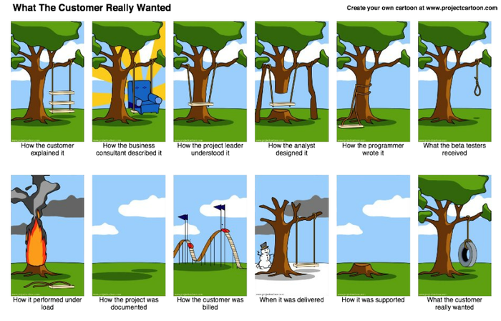

Slide 4
Why Requirement Management Plan
• To plan requirements and to track requirements.
• To prioritize requirements.
• To facilitate configuration management activities such as: how changes to the product will be initiated, how impacts will be analyzed, how they will be traced, tracked, and reported, as well as the authorization levels required to approve these changes.
• Product metrics that will be used and the rationale for using them; and
• Traceability structure to reflect which requirement attributes will be captured on the traceability matrix.

Slide 5
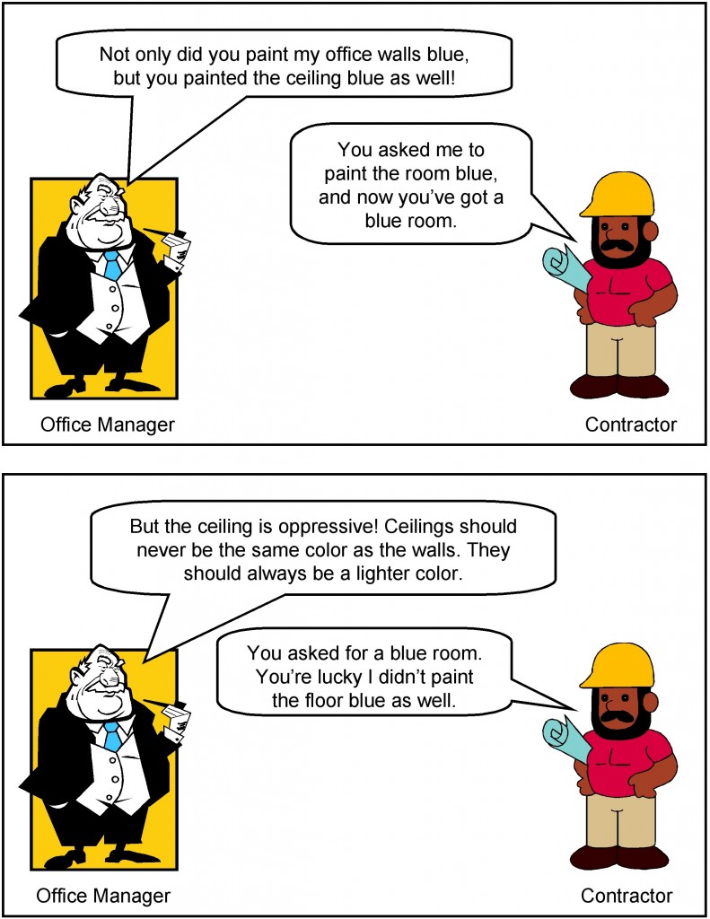

Slide 6
Requirement Categories
Business requirements
Stakeholder requirements
Transition requirements
Quality requirements
Solution requirements, which describe features, functions, and characteristics of the product, service, or result that will meet the business and stakeholder requirements. Solution requirements are further grouped into functional and nonfunctional requirements:

Slide 7
Nonfunctional requirements supplement functional.
Examples include: reliability, security, performance, safety, level of service, supportability, retention/purge, etc.
Functional requirements describe the behaviors of the product. Examples include processes, data, and interactions with the product.

Slide 8
Collect Requirements
Collect Requirements is the process of determining, documenting, and managing stakeholder needs and requirements to meet project objectives.

Slide 9
Collect Requirement Tools
Prototypes
Document analysis
Group creativity techniques
Brainstorming.
Idea/mind mapping.
Affinity diagram.
Multicriteria decision analysis.

Slide 10


Slide 11
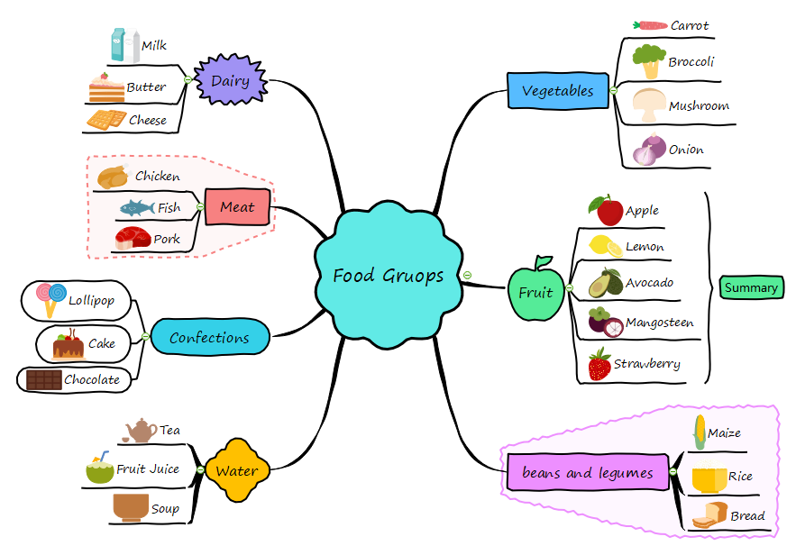

Slide 12
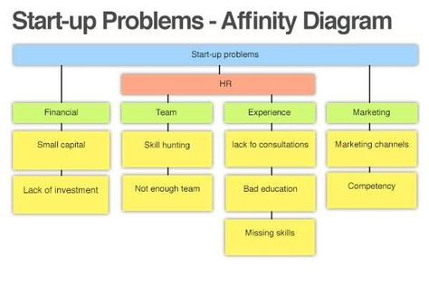

Slide 13
Observations
Interviews
Focus Groups
Questionnaires and surveys

Slide 14


Slide 15
Benchmarking
context diagram
Facilitated workshops

Slide 16
Requirements Traceability Matrix
The requirements traceability matrix is a grid that links product requirements from their origin to the deliverables that satisfy them.
It provides a means to track requirements throughout the project life cycle, helping to ensure that requirements approved in the requirements documentation are delivered at the end of the project.

Slide 17
